Slide 1
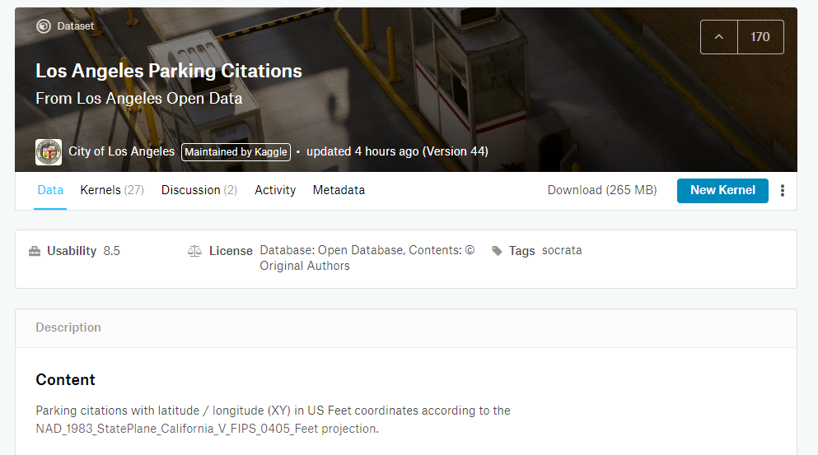
Data set: Los Angeles parking citations db 1
https://www.kaggle.com/cityofLA/los-angeles-parking-citations

Slide 2

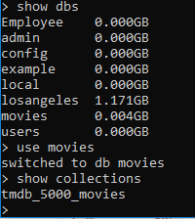

Data set-tmdb_5000

Slide 3
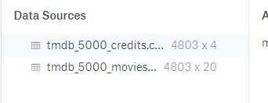

Data set

Slide 4
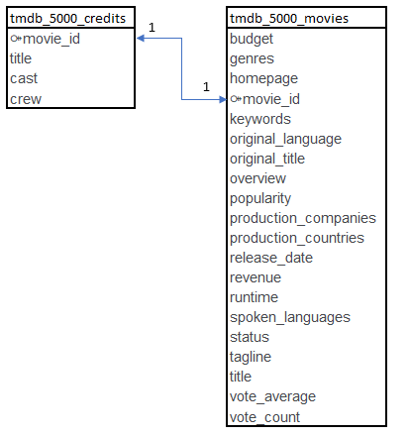
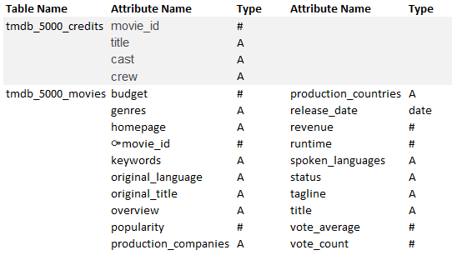
The database

